Slide 1
HOTEL BOOKING DATASET

Slide 2
INTRODUCTION
In the dynamic landscape of the hospitality industry, understanding and predicting the customer satisfaction plays an important role for effective management and resource allocation. In this project, we aim to explore the predictive power of various features in hotel booking dataset to determine whether the booking is likely to be cancelled or not.

Slide 3
Data Collection Process
We have collected the dataset from Kaggle.
It contains 22 variables and converted hotel,arrival_date_month,reserved_room_type and assigned_room_type column values into number format in order to increase the accuracy.
“is_cancelled” column is the target variable which indicates whether the booking is cancelled or not. This binary variable serves as the focal point for enabling the classification of bookings into two categories cancelled (1) and not cancelled (0).

Slide 4
Data Summarization
We have performed descriptive statistics on all numeric variables in order to provide an overview of data’s key characteristics.
Descriptive statistics include mean, standard error, median, mode, standard deviation, sample variance, kurtosis, skewness, range, minimum, maximum, sum and count of the variables.
According to the business question, variables like lead_time, total_of_special_requests, assigned_room_type, reserved_room_type, previous_cancellations, is_cancelled, is_repeated_guest and days_in_a_waiting_list are likely to be more crucial in this dataset.

Slide 5
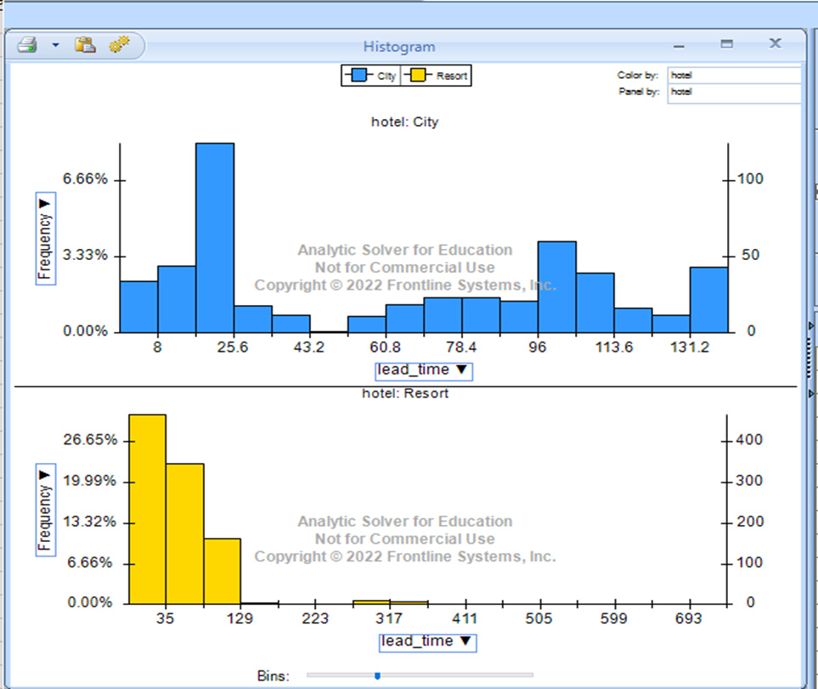
Data Visualization: Histogram of Lead_Time:
From the histogram, we can conclude that lead_time(number of days between booking and arrival) is more for resort type hotel.

Slide 6
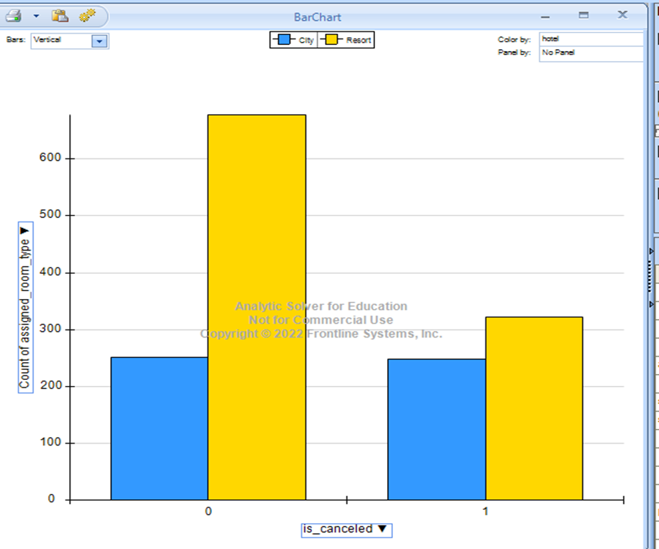
Bar Chart for room_type:
we can predict that number of cancellations for resort type hotel is less when compared with the non-cancelled bookings.

Slide 7
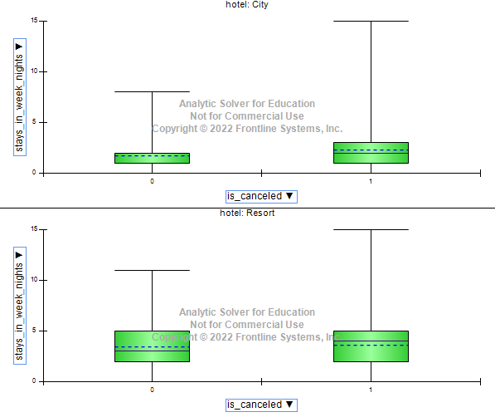
Box plot for stays_in_week_nights and is_cancelled:

Slide 8
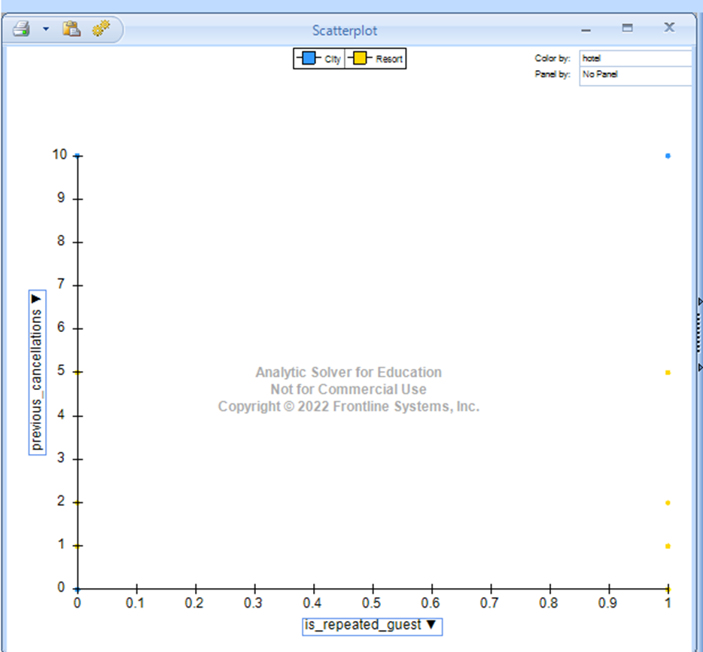
Scatter plot for previous_cancellations and is_repeated_guest
we can say that there is a no relationship between the previous_cancellations and is_repeated_guest variables in the dataset.

Slide 9
Data Analysis
We are using two data mining techniques such as logistic regression and KNN in order to predict the outcome for hotel booking cancellations.
Logistic Regression: Logistic Regression is widely used statistical method for predicting the binary outcomes. Context of our business question is predicting whether booking will be cancelled or not – Logistic regression is suitable because it models the probability of binary outcome.
KNN:
KNN is non parametric and instance-based learning algorithm used for both classification and regression tasks.

Slide 10
Implementation for Logistic Regression
Data Splitting: The dataset is divided into training and validation set used for model training and a validation set used for model evaluation. The split ratio is 60 – 40
Feature Selection: We have considered all the features except name of the customer, phone number and arrival_date_year.
Data Preprocessing: we have created the dummy variables for two columns assigned_room_type and reserved_room_type.

Slide 11
Features considered
Lead_time
Arrival_date_month
Arrival_date_week_number
Arrival_date_day_of_month
Stays_in_weekend_nights
Stays_in_week_nights
Adults
Children
Babies
Is_repeated
Previous_cancellations
Booking_changes
Days_in_waiting_list
Required_car_parking_spaces
Total_special_requests
Is_cancelled

Slide 12
Implementation for KNN
Data Splitting: The dataset is divided into training and validation set used for model training and a validation set used for model evaluation. The split ratio is 60 – 40
Feature Scaling: KNN is distance-based, it is essential to scale the features to bring them to a similar scale. Standardization or normalization is commonly applied.
Choosing K value

Slide 13
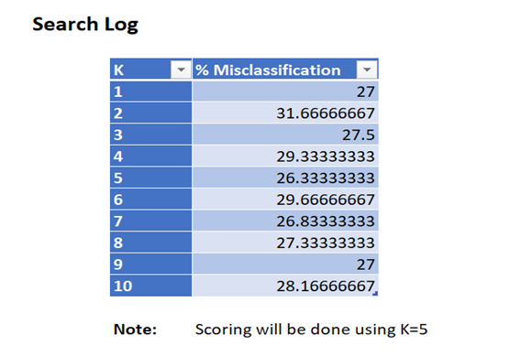
After performing KNN technique with maximum K value as 10, we get the best K value
The best K value is 5

Slide 14
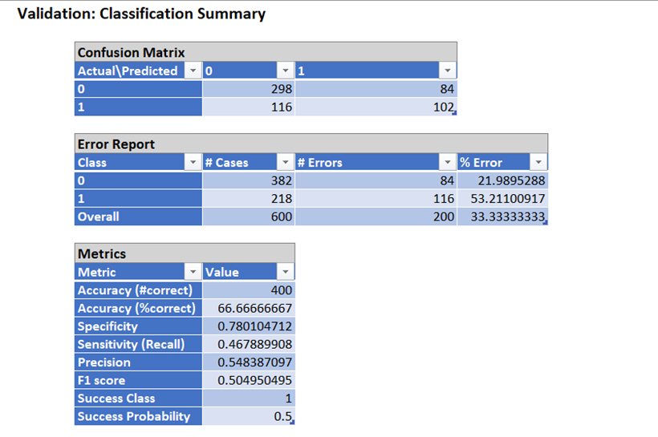
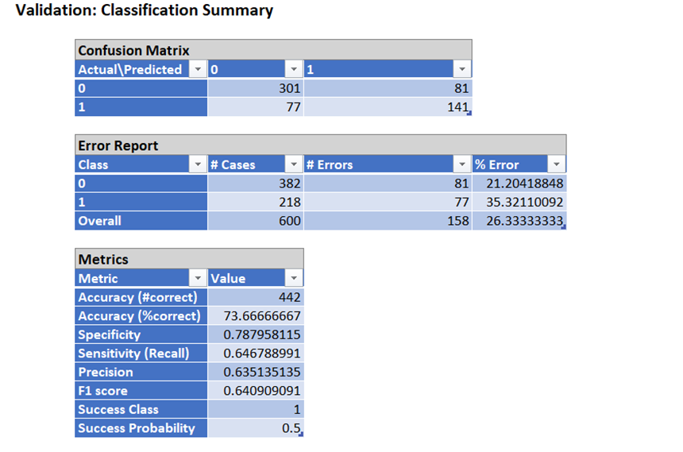
Result and Analysis
Logistic Regression
KNN

Slide 15
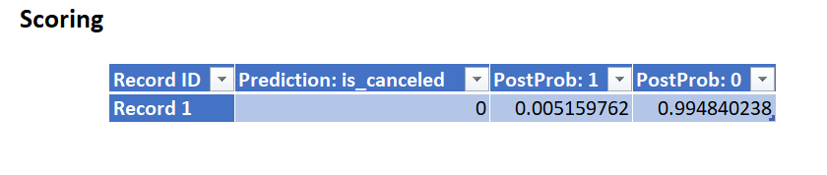
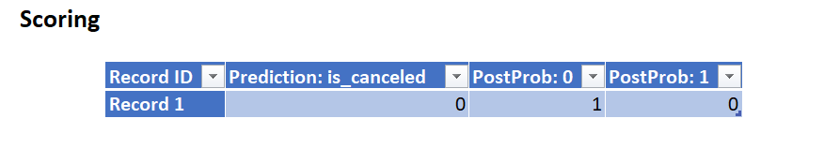
Classification of booking cancellation for a new customer with lead_time = 216
For Logistic Regression
For KNN

Slide 16
Comparison
Accuracy: KNN performs better in terms of overall accuracy, achieving a 7% higher accuracy compared to logistic regression.
Sensitivity: KNN has higher sensitivity which indicates a better ability to identify instances of cancellations. This aligns with the business question's focus on predicting cancellations.
Precision: Precision is comparable between the two models, KNN maintaining a slightly higher precision.
F1 Score: KNN has a higher F1 score, indicating a more balanced performance in terms of precision and recall.

Slide 17
Summary
Both models provide insights into the likelihood of hotel booking cancellations.
Logistic Regression is achieving moderate accuracy may benefit from further refinement to improve sensitivity.
On the other hand, KNN exhibits improved overall performance particularly in identifying instances of cancellations.

Slide 18


